Slide 1
DATA PUBLISH PROCESS & MESSAGE QUEUE

Slide 2
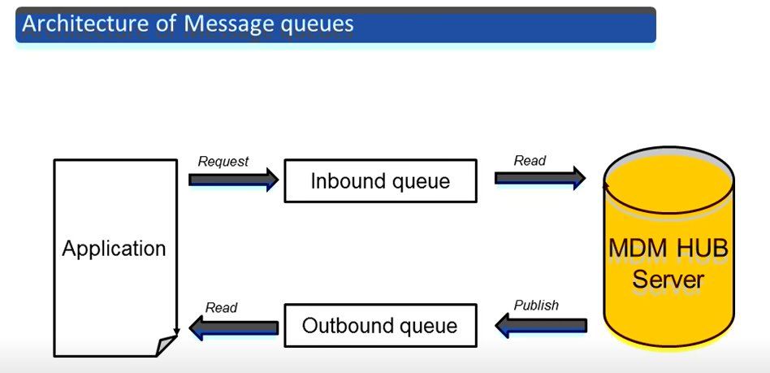
OutBound Queue is most commonly used.
Outbound is for Data Publishing

Slide 3
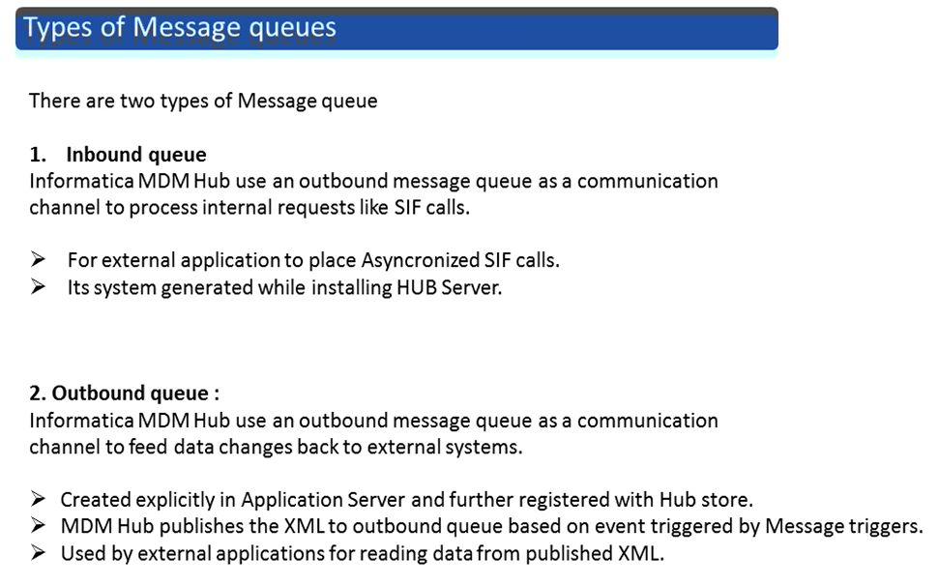
MQ:

Slide 4
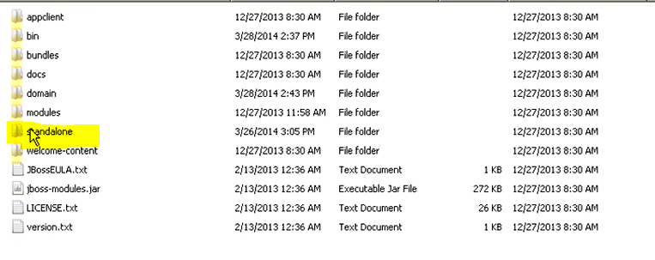
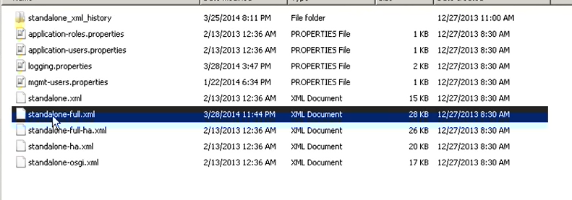
MQ Setup:
JBOSS EAP → Standalone → Config → standalone-full.xml

Slide 5
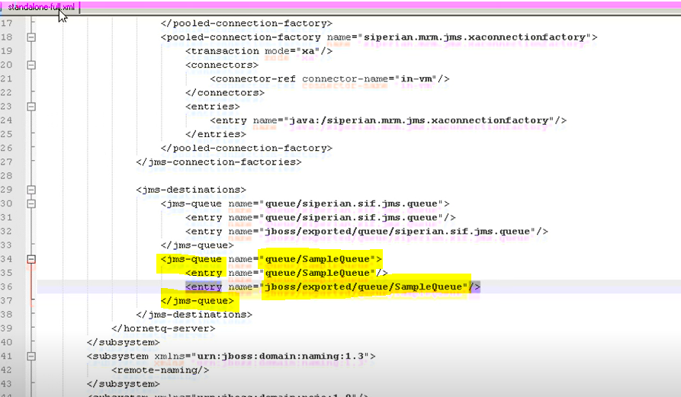
Create a Sample Queue
Then Restart the JBOSS server

Slide 6
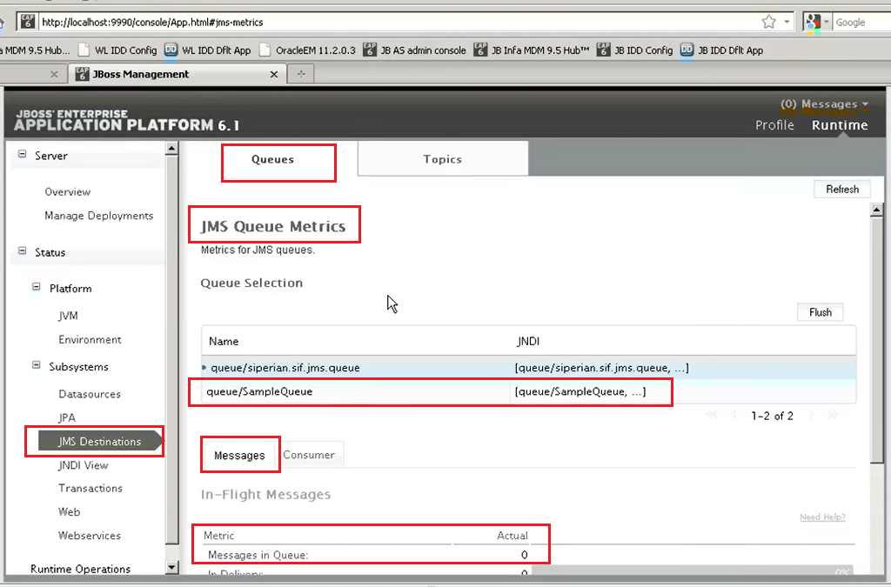
After JBOSS restart.
Login to JBOSS UI . Inside JMS Destination , you will see the MQ, which you have created.

Slide 7
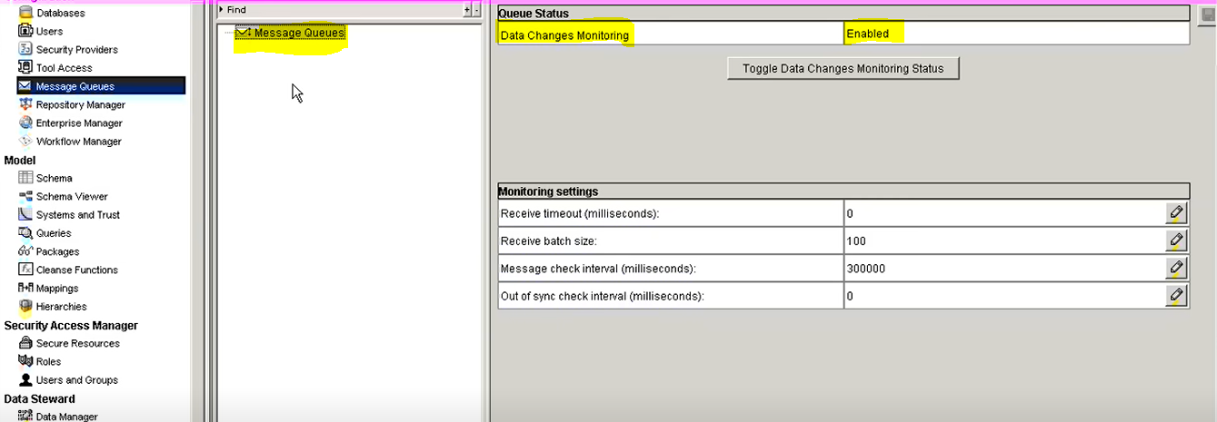
MDM Setup for MQ

Slide 8
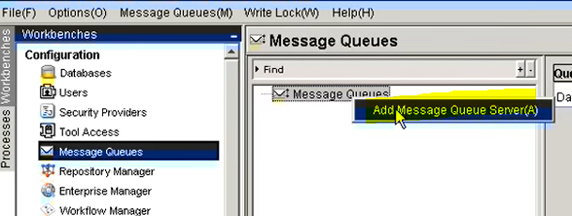
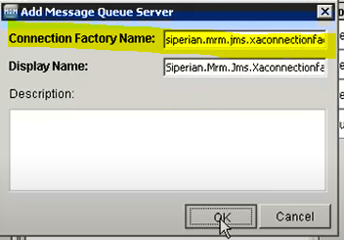
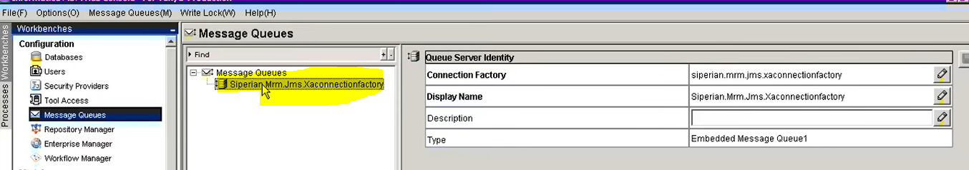
Connection Factory Name : this must be
siperian.mrm.jms.xaconnectionfactory

Slide 9
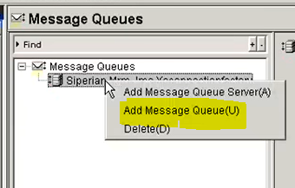
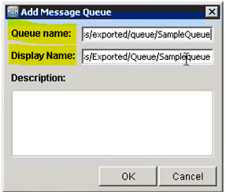
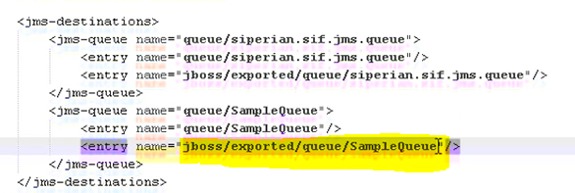
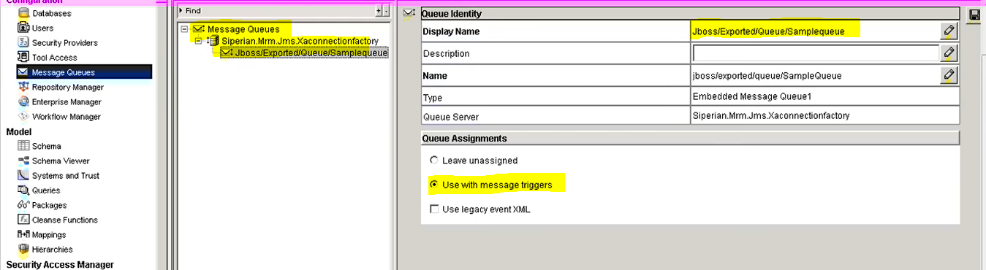
QUEUE Name: Must be same as the queue details you provided in JBOSS standalone-full.xml file

Slide 10
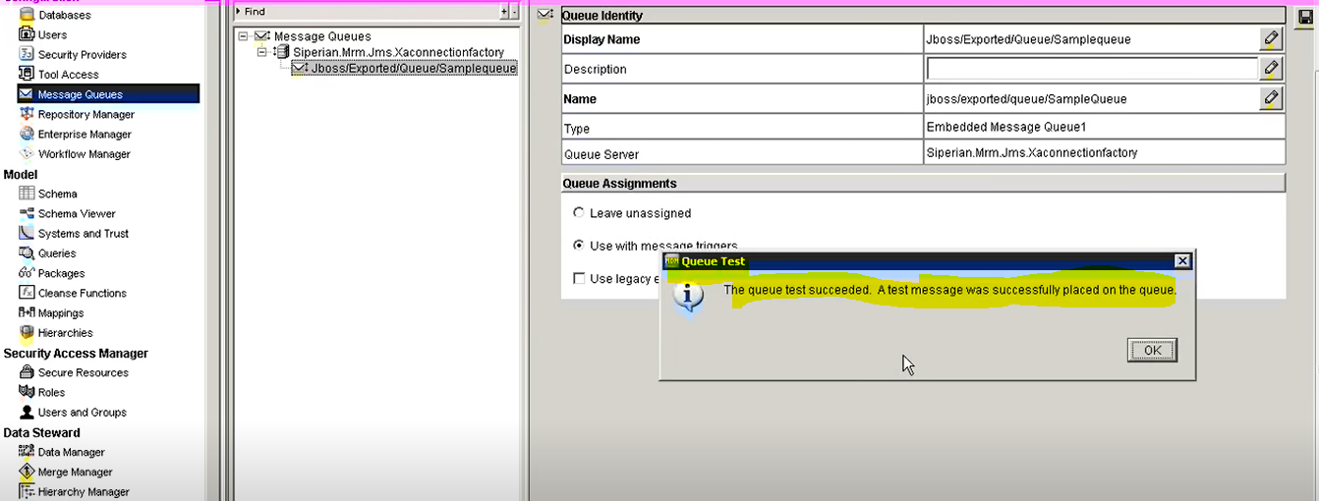
Click on “Test” button to test the MQ.
If the configuration is proper then a dummy message will be placed in MQ Channel.

Slide 11
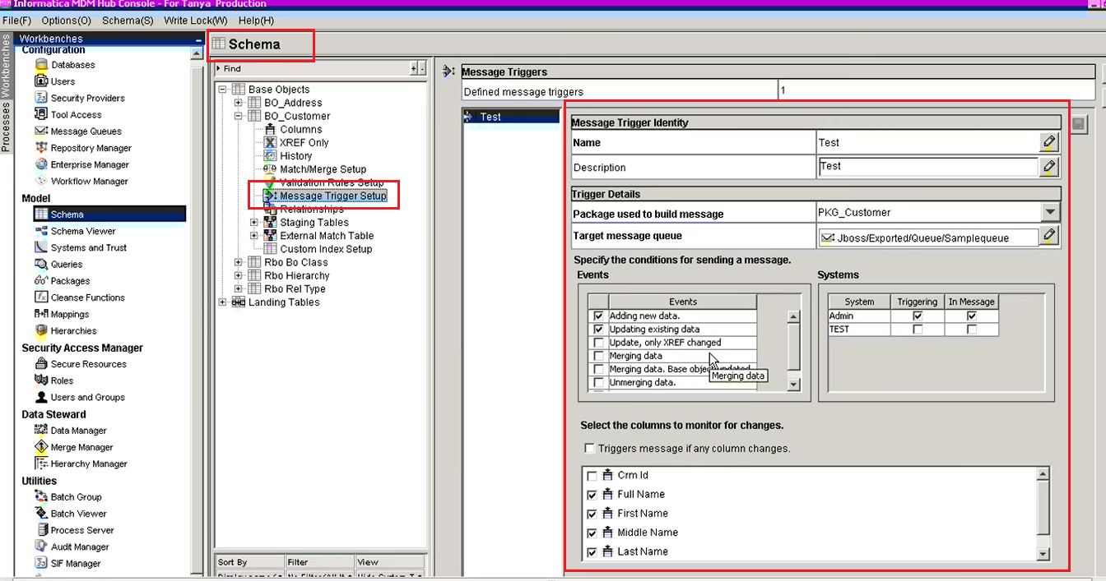
Message Trigger setup → will be done by developer
This trigger will place the data based on event setup in the MQ channel.
Events can be : Create , update, Match, Merge of records

Slide 12
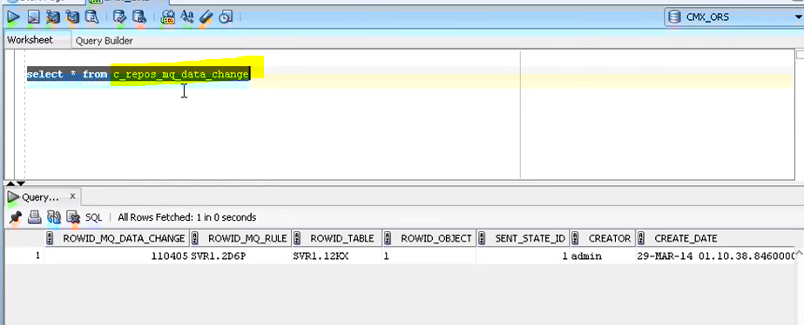
C_REPOS_MQ_DATA_CHANGE is the REPOS table where you can see the published data details.

Slide 13
In Real Time project :
Use IDQ, PwC to publish the data in batch process
Use Mulesoft or ADO – Azure Data Factory to publish the data

